Slide 1
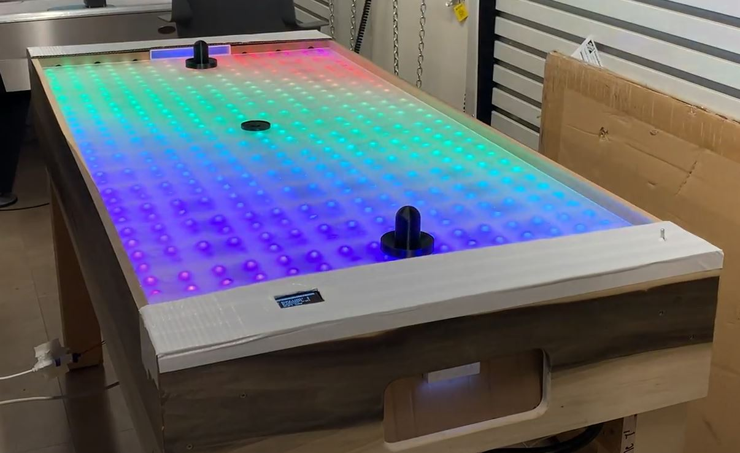
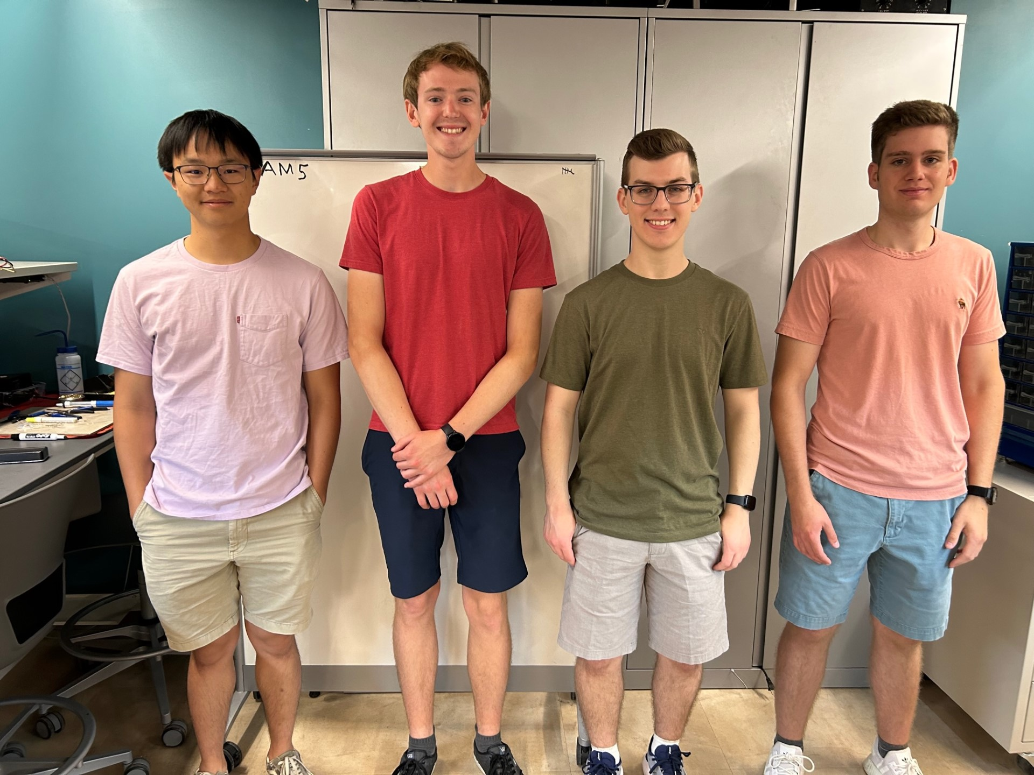
Final Project Presentation
Team 05 – Smart Air Hockey Table

Slide 2
Outline
Project Overview
Block Diagram
Design Challenges
Member Contributions
Project Demonstration

Slide 3
Project Overview

Slide 4
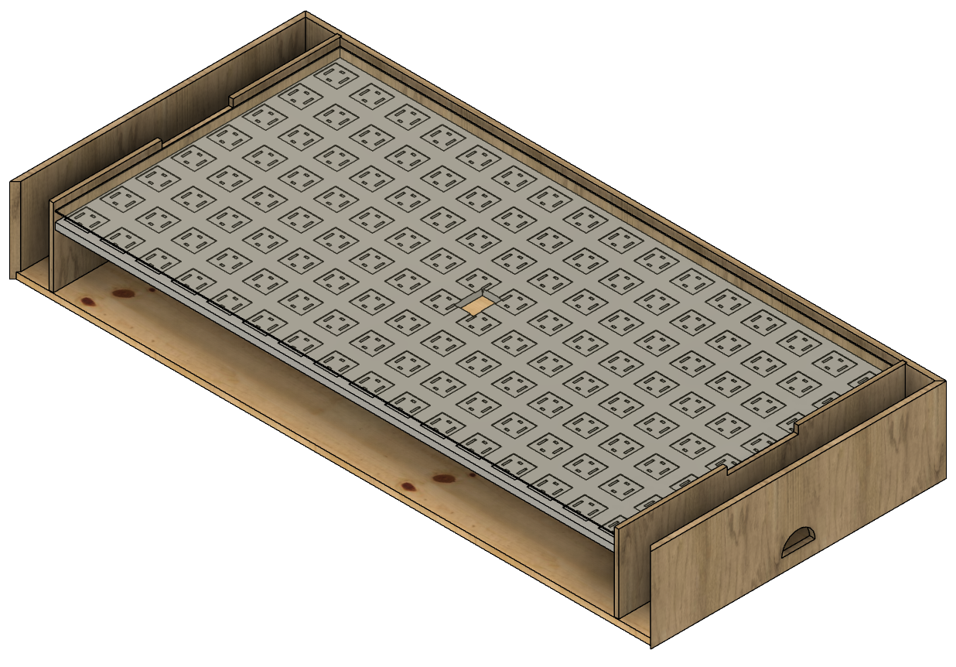
Smart Air Hockey Table (SAHT)
Enhanced Gameplay: Blends air hockey with tech
Dynamic RGB LED Grid: LEDs provide visual feedback
Precise Puck Tracking: Grid of Hall Effect sensors under the playing surface to ensure accurate real-time tracking of a puck embedded with a magnet
Goal Detection: LDR and LED pairs for score detection
OLED Score Display: Side display for score tracking
Power Supply: Power the table from a wall outlet

Slide 5
Block Diagram

Slide 6
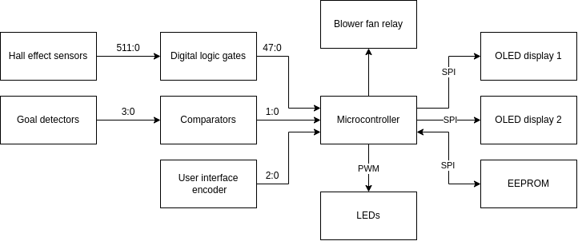
Block Diagram

Slide 7
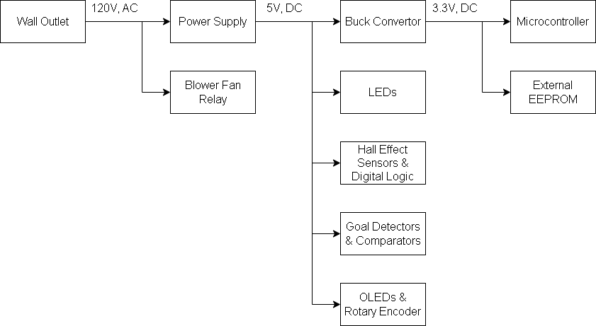
Power Diagram

Slide 8
Design Challenges

Slide 9
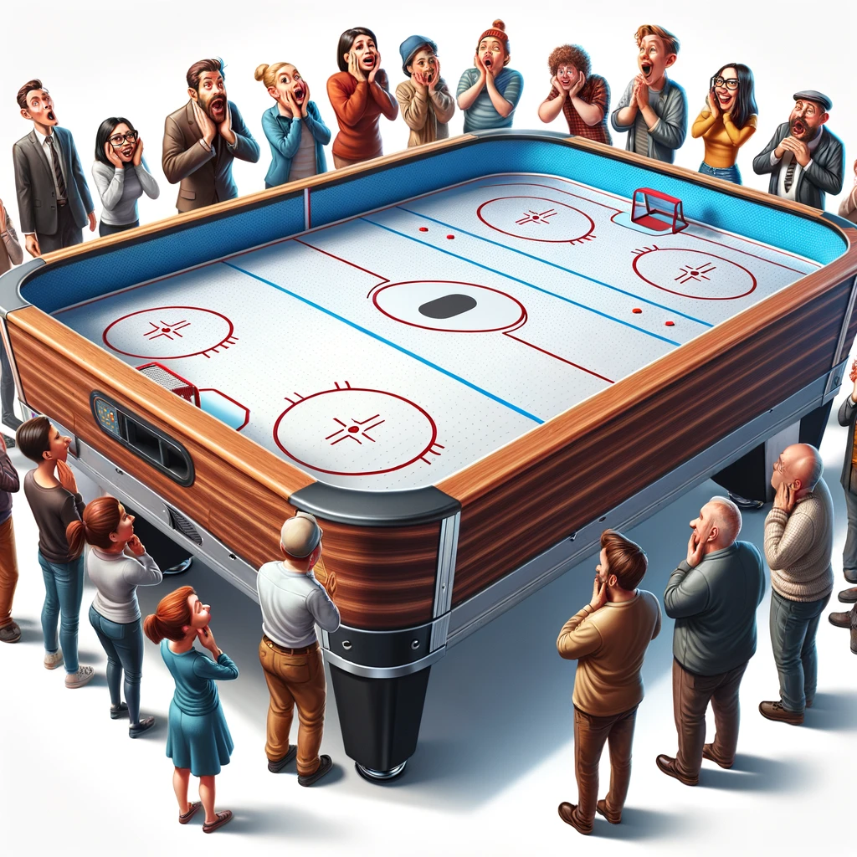
It’s a big table!
It’s a really big table! (Almost 6’ x 3’)
Simplicity and modularity were key to keep cost and complexity down
Matrix of 128 PCBs, 512 LEDs, 512 sensors, >1.3k wires, and so much more
Notes:
It’s a really big table
Will need a lot to cover the whole table
How to control everything?
Would one micro be enough? How do we track puck and communicate with LEDs?

Slide 10
It’s a big table!
It’s a really big table! (Almost 6’ x 3’)
Simplicity and modularity were key to keep cost and complexity down
Matrix of 128 PCBs, 512 LEDs, 512 sensors, >1.3k wires, and so much more
How to control everything?
Offloaded computation to other components, away from the microcontroller
Ended up with one microcontroller with nearly 100 pins being used
Notes:
It’s a really big table
Will need a lot to cover the whole table
How to control everything?
Would one micro be enough? How do we track puck and communicate with LEDs?

Slide 11
It’s a big table!
It’s a really big table! (Almost 6’ x 3’)
Simplicity and modularity were key to keep cost and complexity down
Matrix of 128 PCBs, 512 LEDs, 512 sensors, >1.3k wires, and so much more
How to control everything?
Offloaded computation to other components, away from the microcontroller
Ended up with one microcontroller with nearly 100 pins being used
Component assembly could take forever…
Streamlining repeatable processes and assigning tasks
Getting sensor boards assembled, using dupont wires
If we were to do it again, would have looked into pogo pins
Notes:
It’s a really big table
Will need a lot to cover the whole table
How to control everything?
Would one micro be enough? How do we track puck and communicate with LEDs?

Slide 12
We are not air hockey table experts
Airflow (not enough air, too much air, bowing of surface)
A lot of guessing and hoping it would work out
Thankfully, it mostly did

Slide 13
We are not air hockey table experts
Airflow (not enough air, too much air, bowing of surface)
A lot of guessing and hoping it would work out
Thankfully, it mostly did
We are also not carpenters
Took a lot of time to build and design the table

Slide 14
Member Contributions

Slide 15
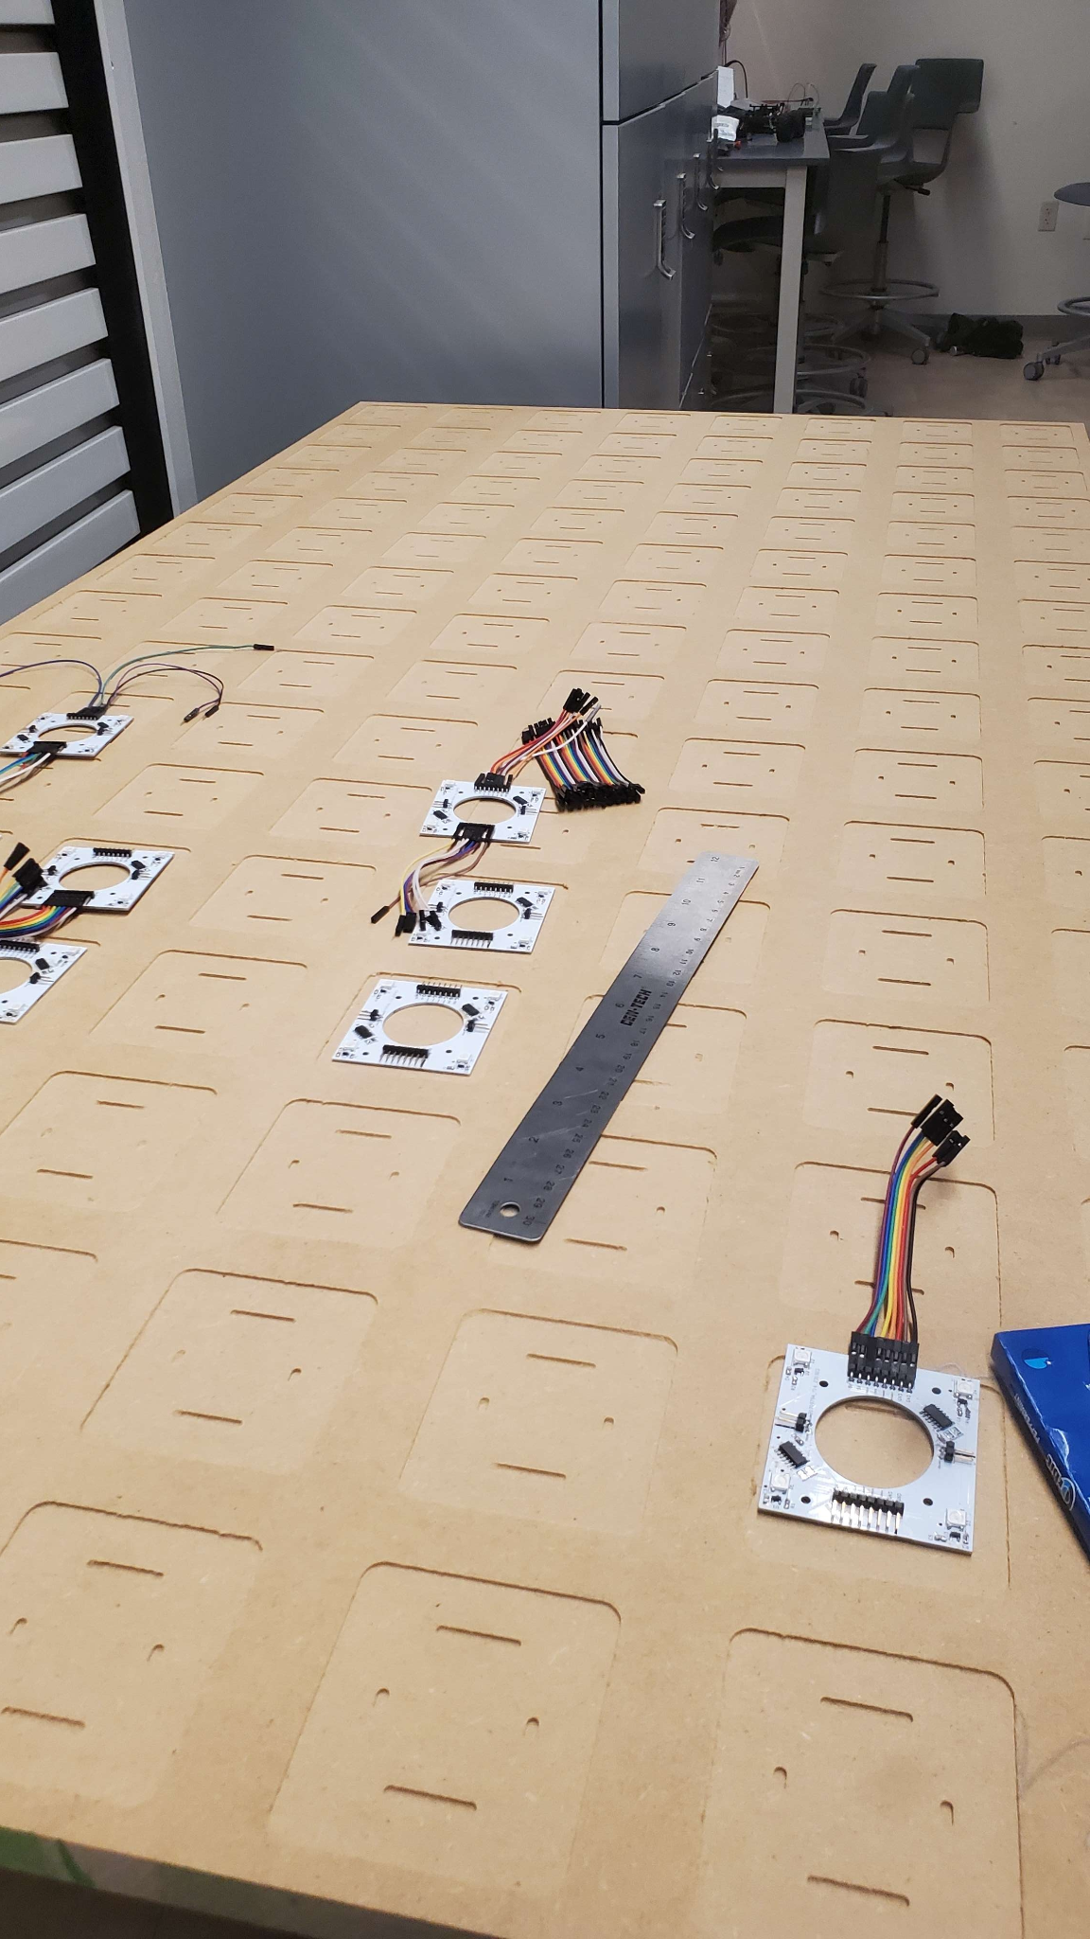
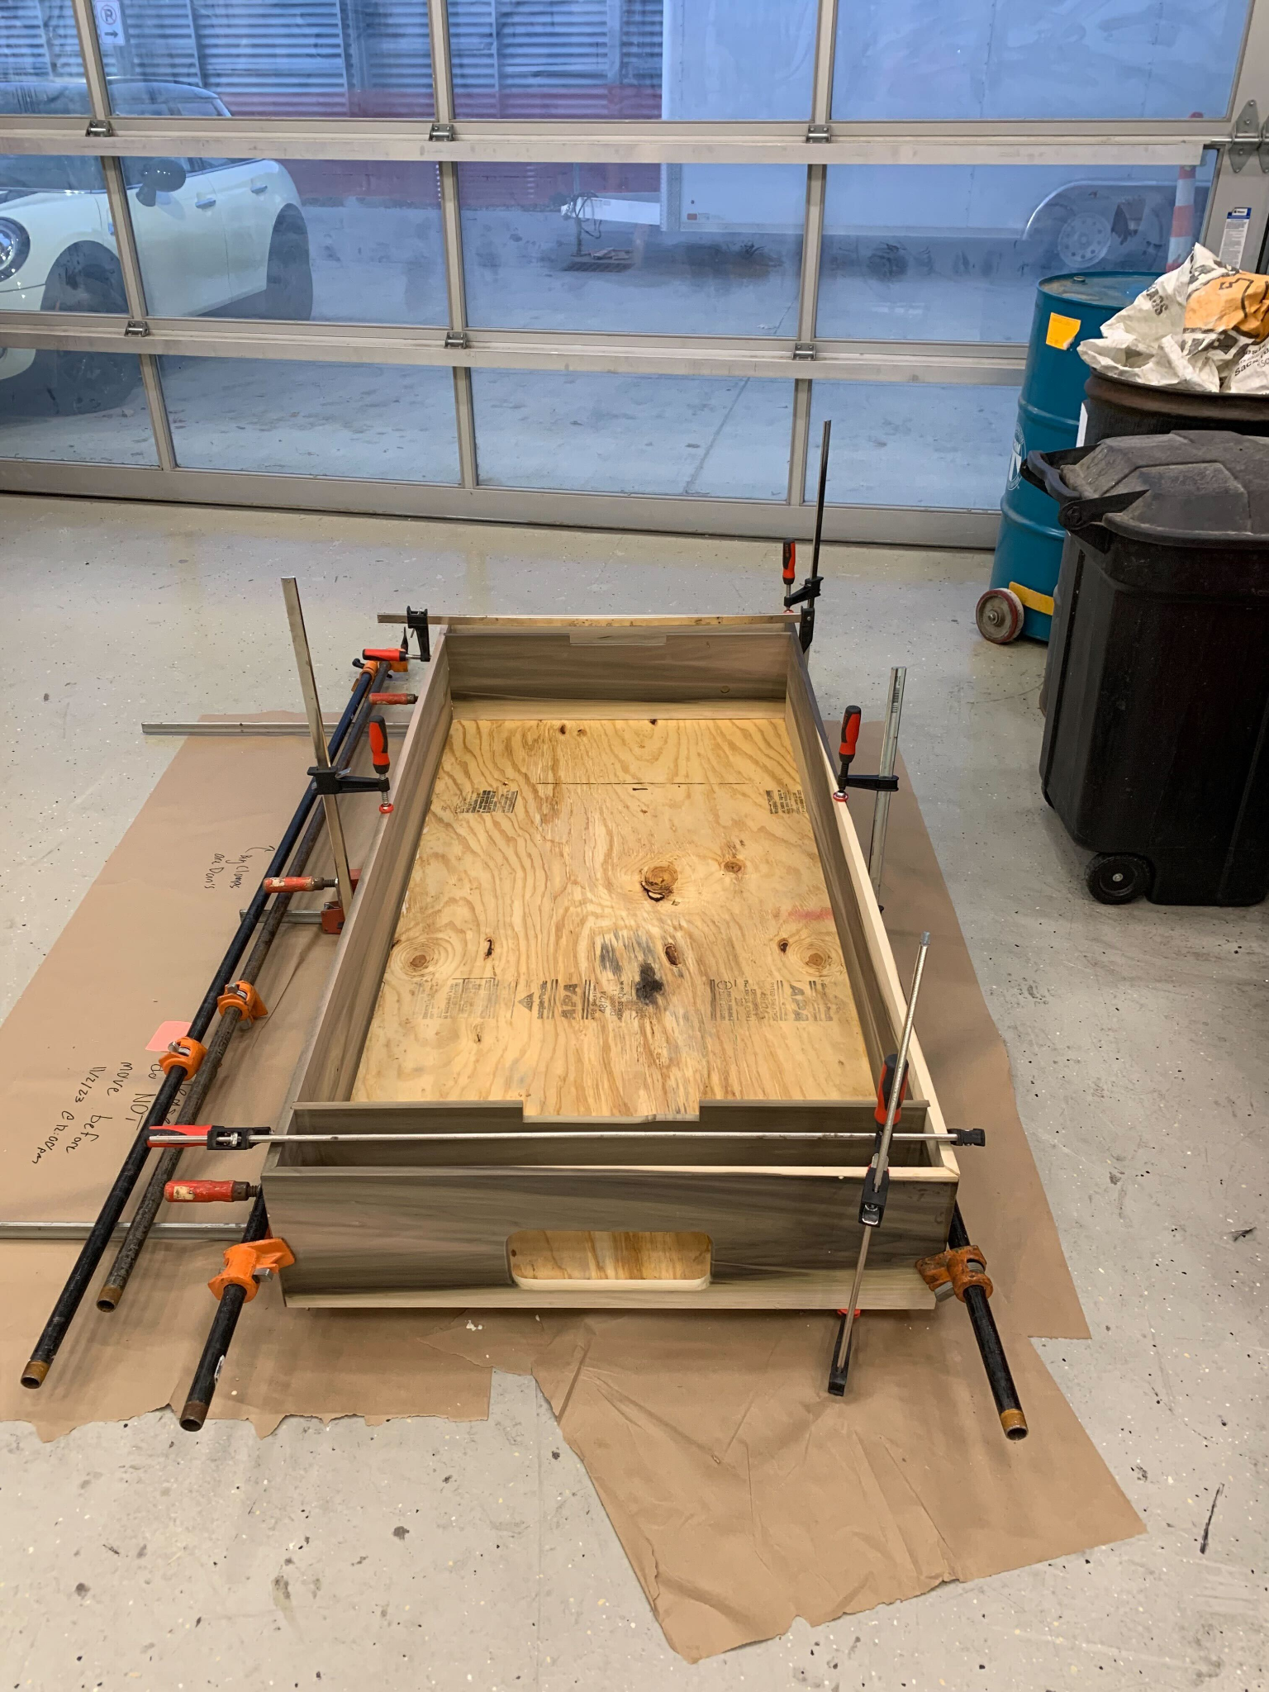
Overview of Individual Contributions (Alan)
Table (Design & Construction)
Overall Body
MDF Middle Level
Acrylic Top Surface

Slide 16
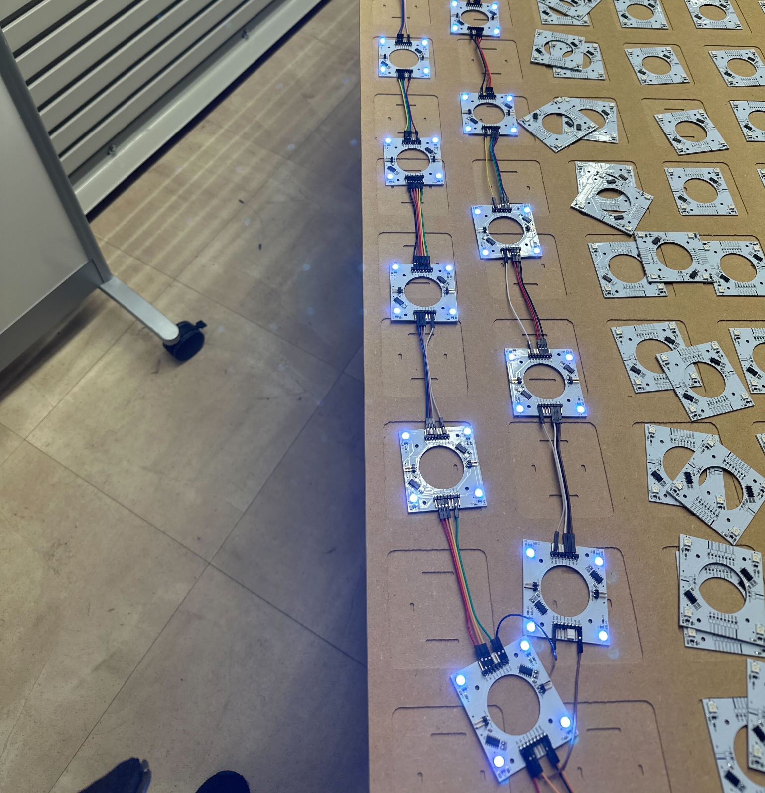
Overview of Individual Contributions (Alan)
Table (Design & Construction)
Overall Body
MDF Middle Level
Acrylic Top Surface
Electronics
Soldering & Testing of Sensor PCBs

Slide 17
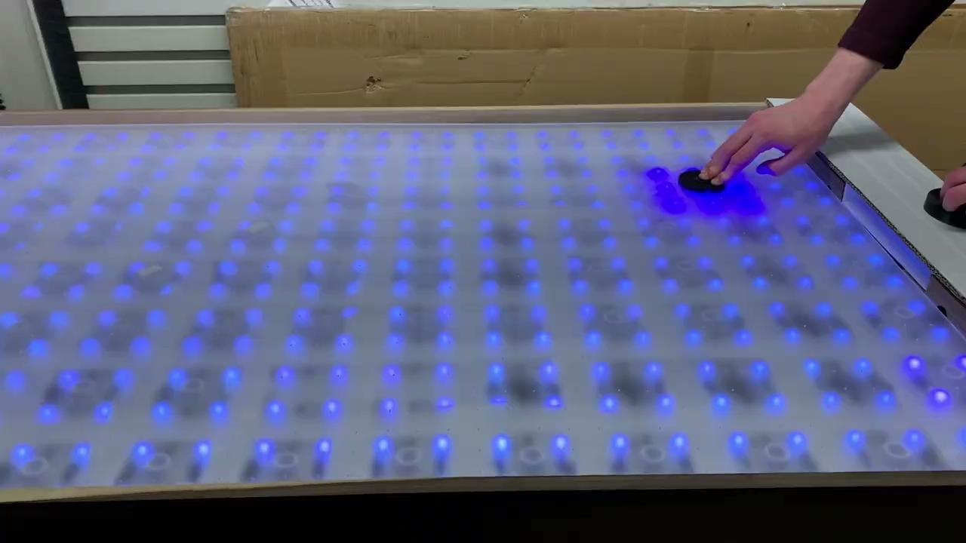
Overview of Individual Contributions (Alan)
Table (Design & Construction)
Overall Body
MDF Middle Level
Acrylic Top Surface
Electronics
Soldering & Testing of Sensor PCBs
Firmware
Optimizations throughout the repo
Integration of trail gameplay and brightness control

Slide 18
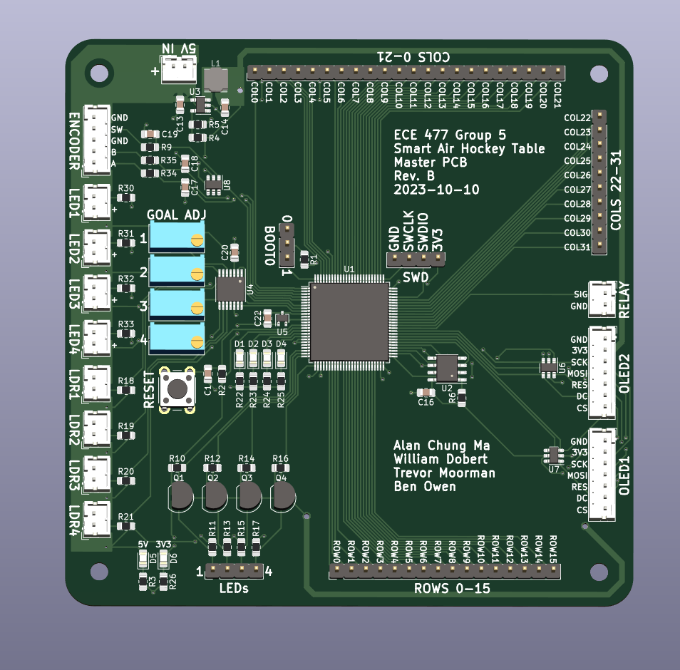
Overview of Individual Contributions (Ben)
Master PCB

Slide 19
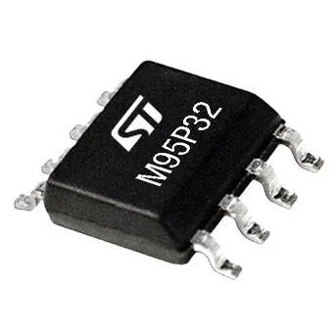
Overview of Individual Contributions (Ben)
Master PCB
Firmware
EEPROM driver

Slide 20
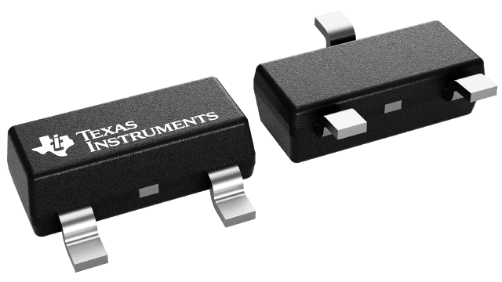
Overview of Individual Contributions (Ben)
Master PCB
Firmware
EEPROM driver
Hall effect sensor driver

Slide 21
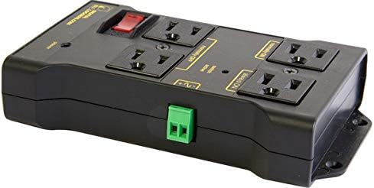
Overview of Individual Contributions (Ben)
Master PCB
Firmware
EEPROM driver
Hall effect sensor driver
Power supply relay driver

Slide 22
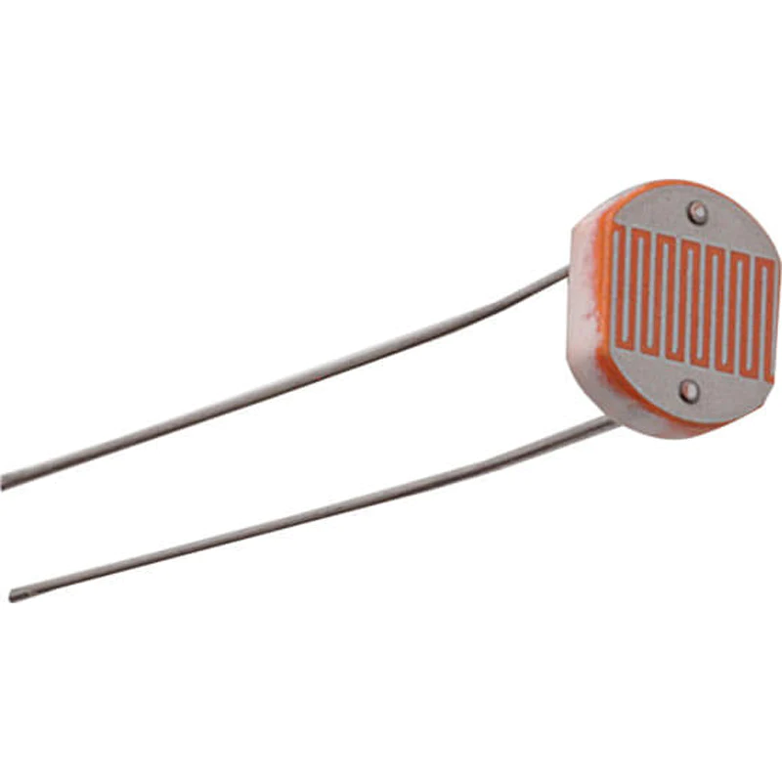
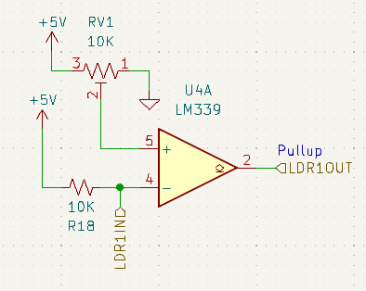
Overview of Individual Contributions (Ben)
Master PCB
Firmware
EEPROM driver
Hall effect sensor driver
Power supply relay driver
Goal detection driver

Slide 23
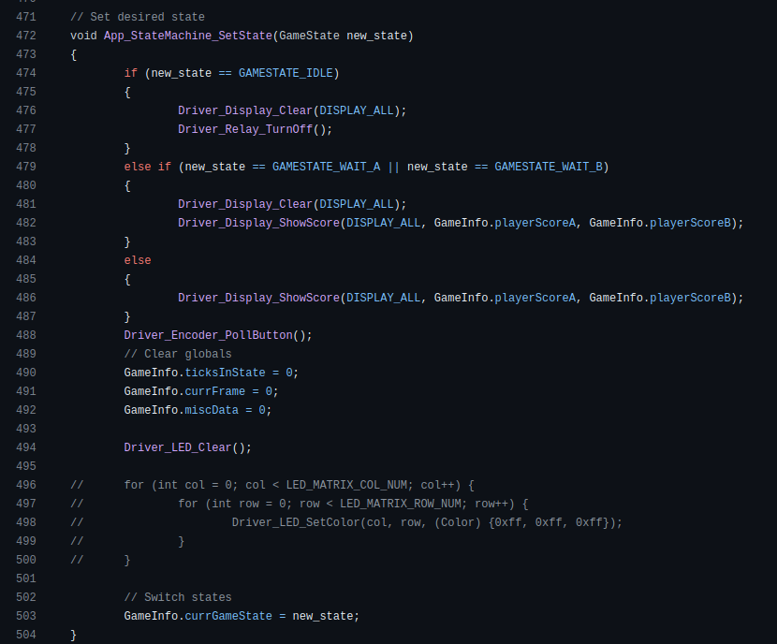
Overview of Individual Contributions (Ben)
Master PCB
Firmware
EEPROM driver
Hall effect sensor driver
Power supply relay driver
Goal detection driver
State machine logic

Slide 24
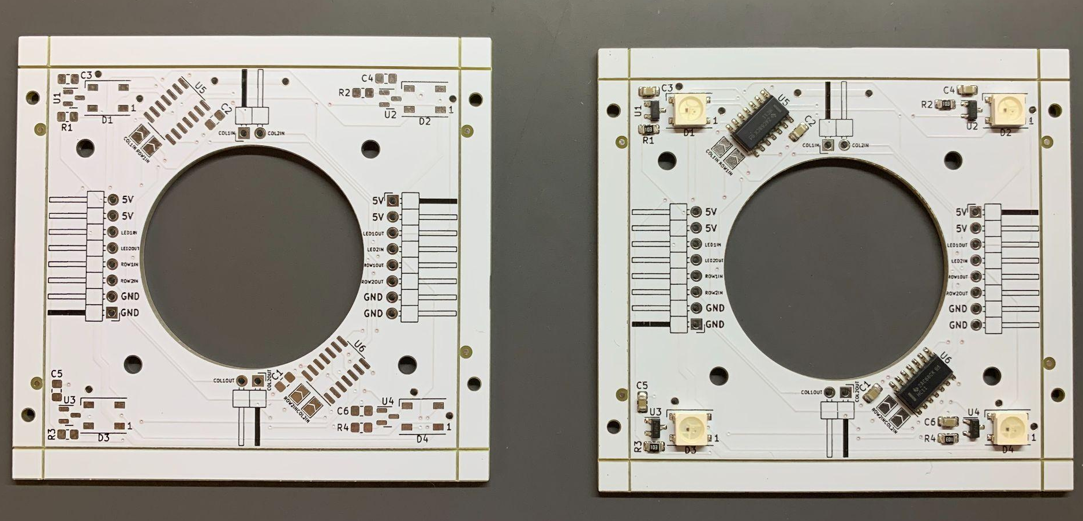
Overview of Individual Contributions (Trevor)
Sensor PCB
Notes:
TODO: Add pic

Slide 25
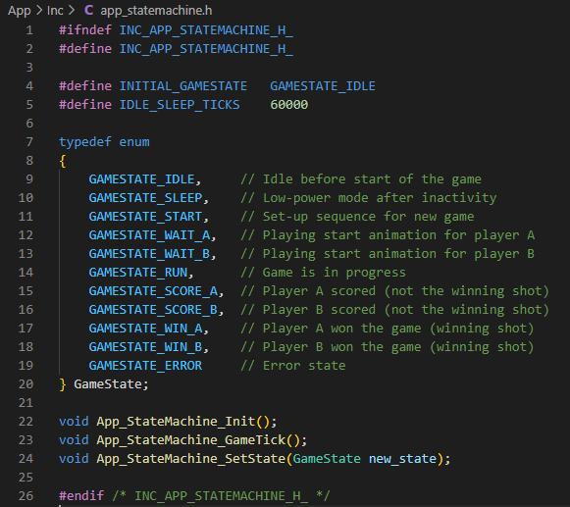
Overview of Individual Contributions (Trevor)
Sensor PCB
Firmware:
State Machine Structure
Notes:
TODO: Add pic

Slide 26
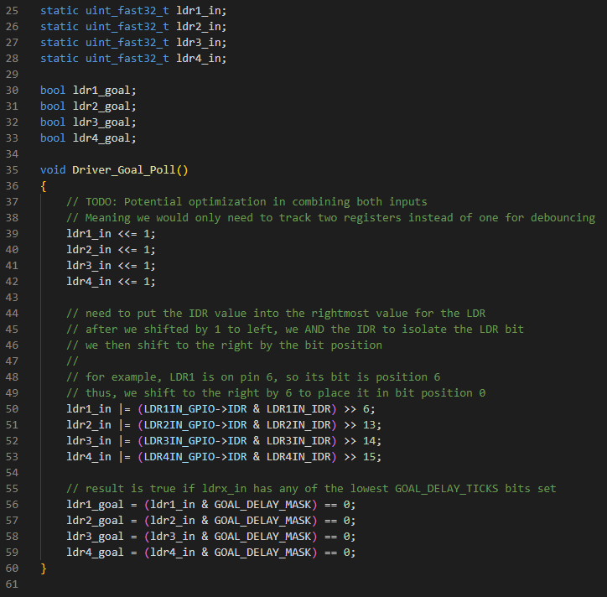
Overview of Individual Contributions (Trevor)
Sensor PCB
Firmware:
State Machine Structure
Goal Detection Driver
Notes:
TODO: Add pic

Slide 27
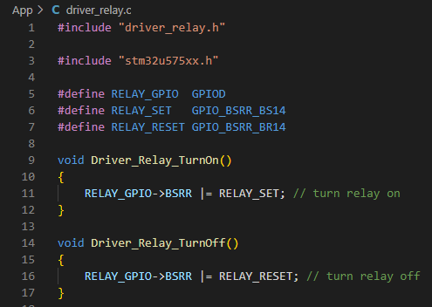
Overview of Individual Contributions (Trevor)
Sensor PCB
Firmware:
State Machine Structure
Goal Detection Driver
Power Relay Driver
Notes:
TODO: Add pic

Slide 28
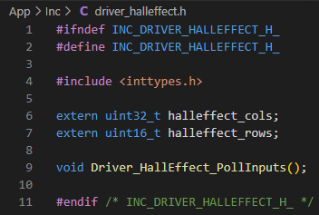
Overview of Individual Contributions (Trevor)
Sensor PCB
Firmware:
State Machine Structure
Goal Detection Driver
Power Relay Driver
Hall Effect Driver
Notes:
TODO: Add pic

Slide 29
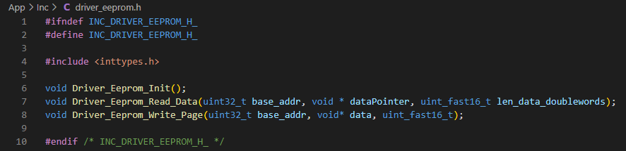
Overview of Individual Contributions (Trevor)
Sensor PCB
Firmware:
State Machine Structure
Goal Detection Driver
Power Relay Driver
Hall Effect Driver
External EEPROM Driver
Notes:
TODO: Add pic

Slide 30
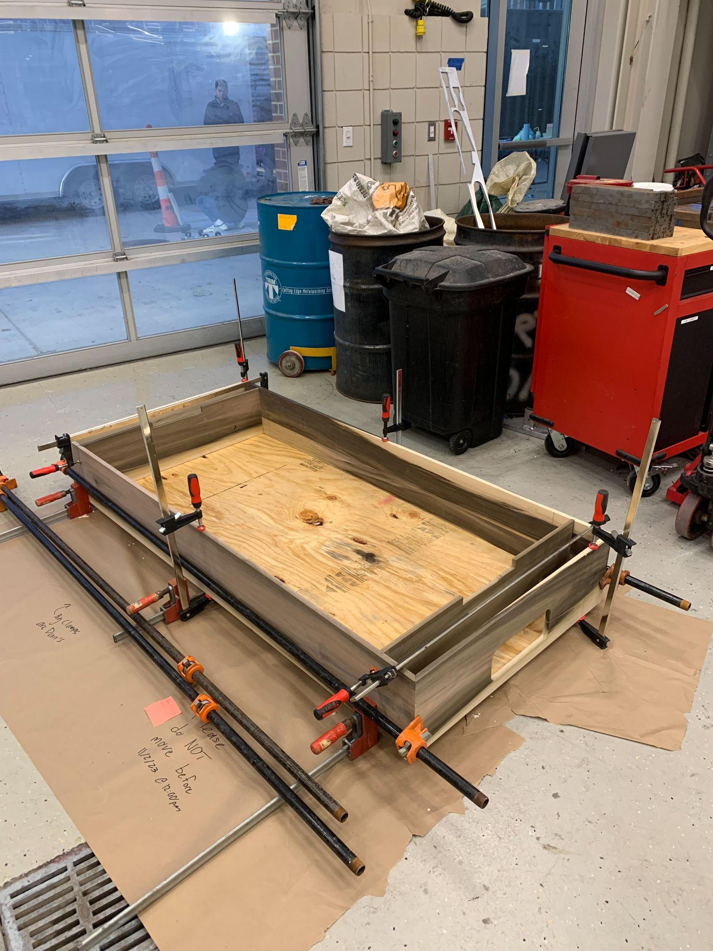
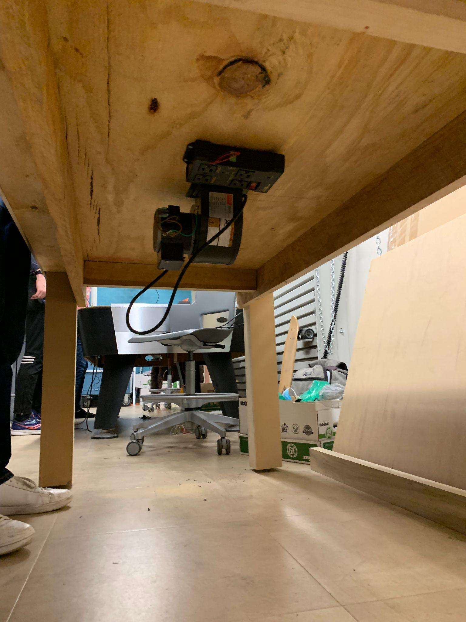
Overview of Individual Contributions (Trevor)
Sensor PCB
Firmware:
State Machine Structure
Goal Detection Driver
Power Relay Driver
Hall Effect Driver
External EEPROM Driver
Mechanical Assembly
Table Body
Table Legs & Supports
Mounting MDF
Table Ends
Notes:
TODO: Add pic

Slide 31
Overview of Individual Contributions (Will)

Slide 32
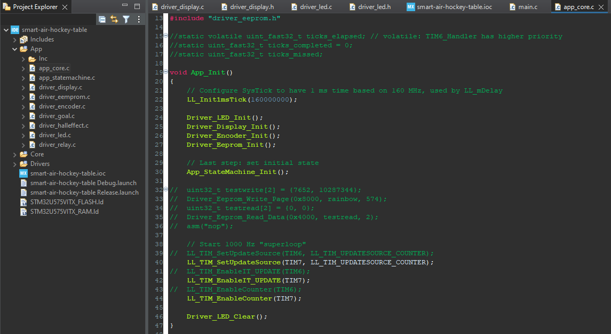
Overview of Individual Contributions (Will)
Overall Firmware Structure

Slide 33
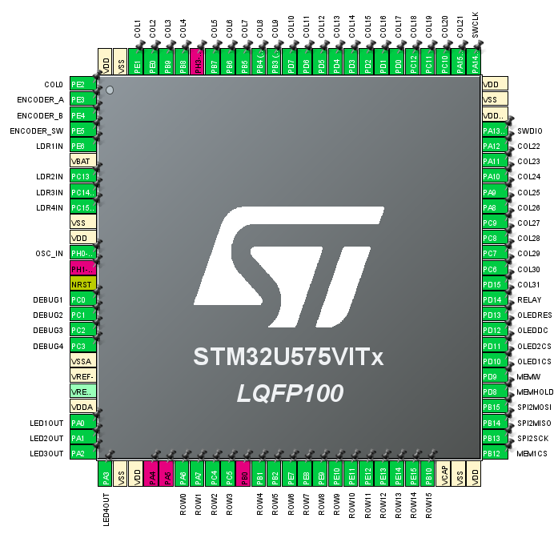
Overview of Individual Contributions (Will)
Overall Firmware Structure
Microcontroller Peripheral Configuration

Slide 34
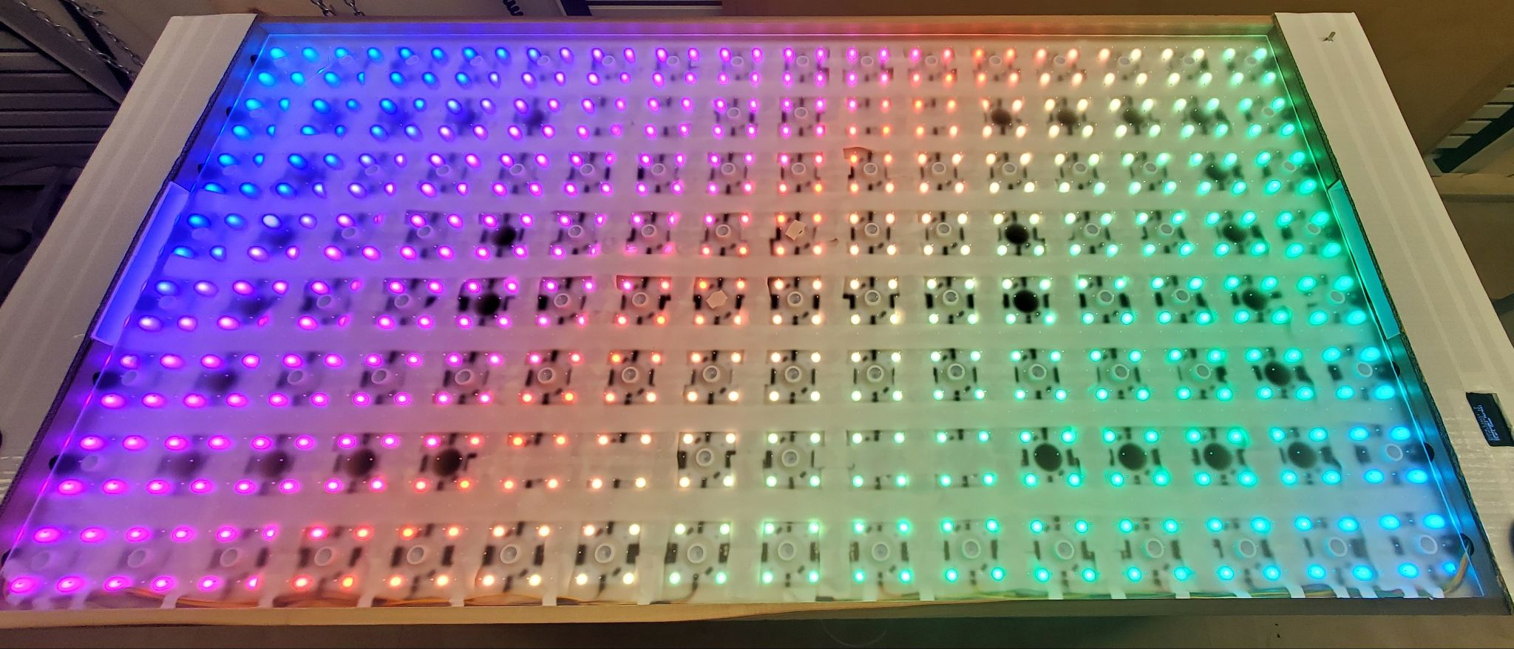
Overview of Individual Contributions (Will)
Overall Firmware Structure
Microcontroller Peripheral Configuration
LED Matrix Driver Firmware

Slide 35
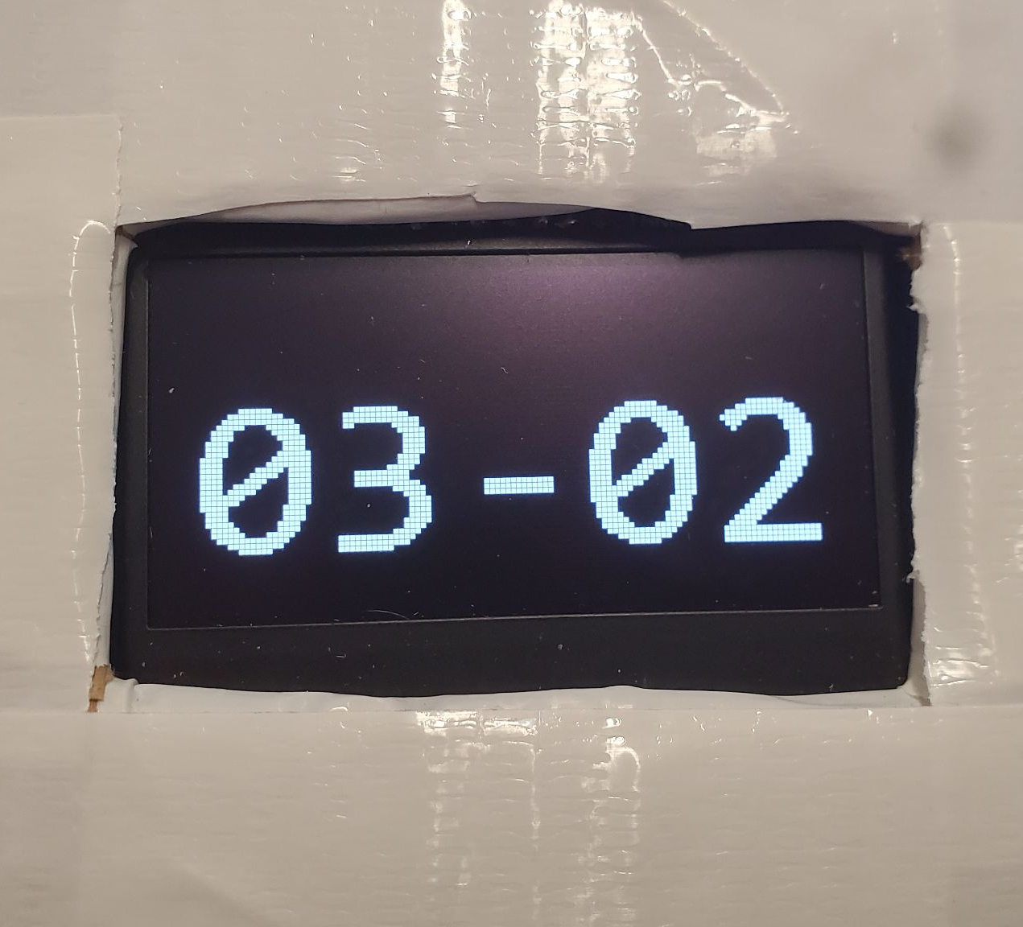
Overview of Individual Contributions (Will)
Overall Firmware Structure
Microcontroller Peripheral Configuration
LED Matrix Driver Firmware
Score Display Driver Firmware

Slide 36
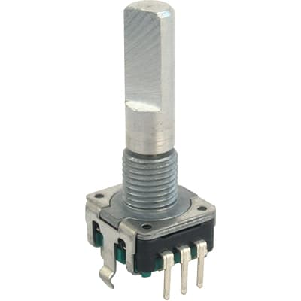
Overview of Individual Contributions (Will)
Overall Firmware Structure
Microcontroller Peripheral Configuration
LED Matrix Driver Firmware
Score Display Driver Firmware
Rotary Encoder Driver Firmware

Slide 37
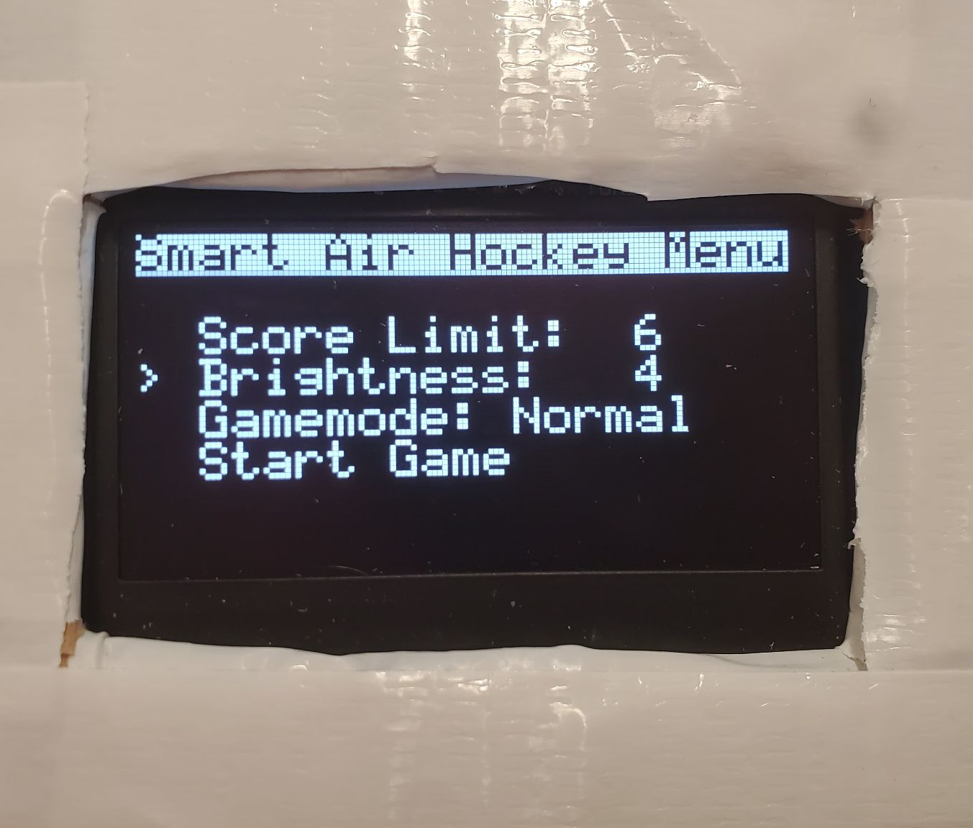
Overview of Individual Contributions (Will)
Overall Firmware Structure
Microcontroller Peripheral Configuration
LED Matrix Driver Firmware
Score Display Driver Firmware
Rotary Encoder Driver Firmware
Menu System Software

Slide 38
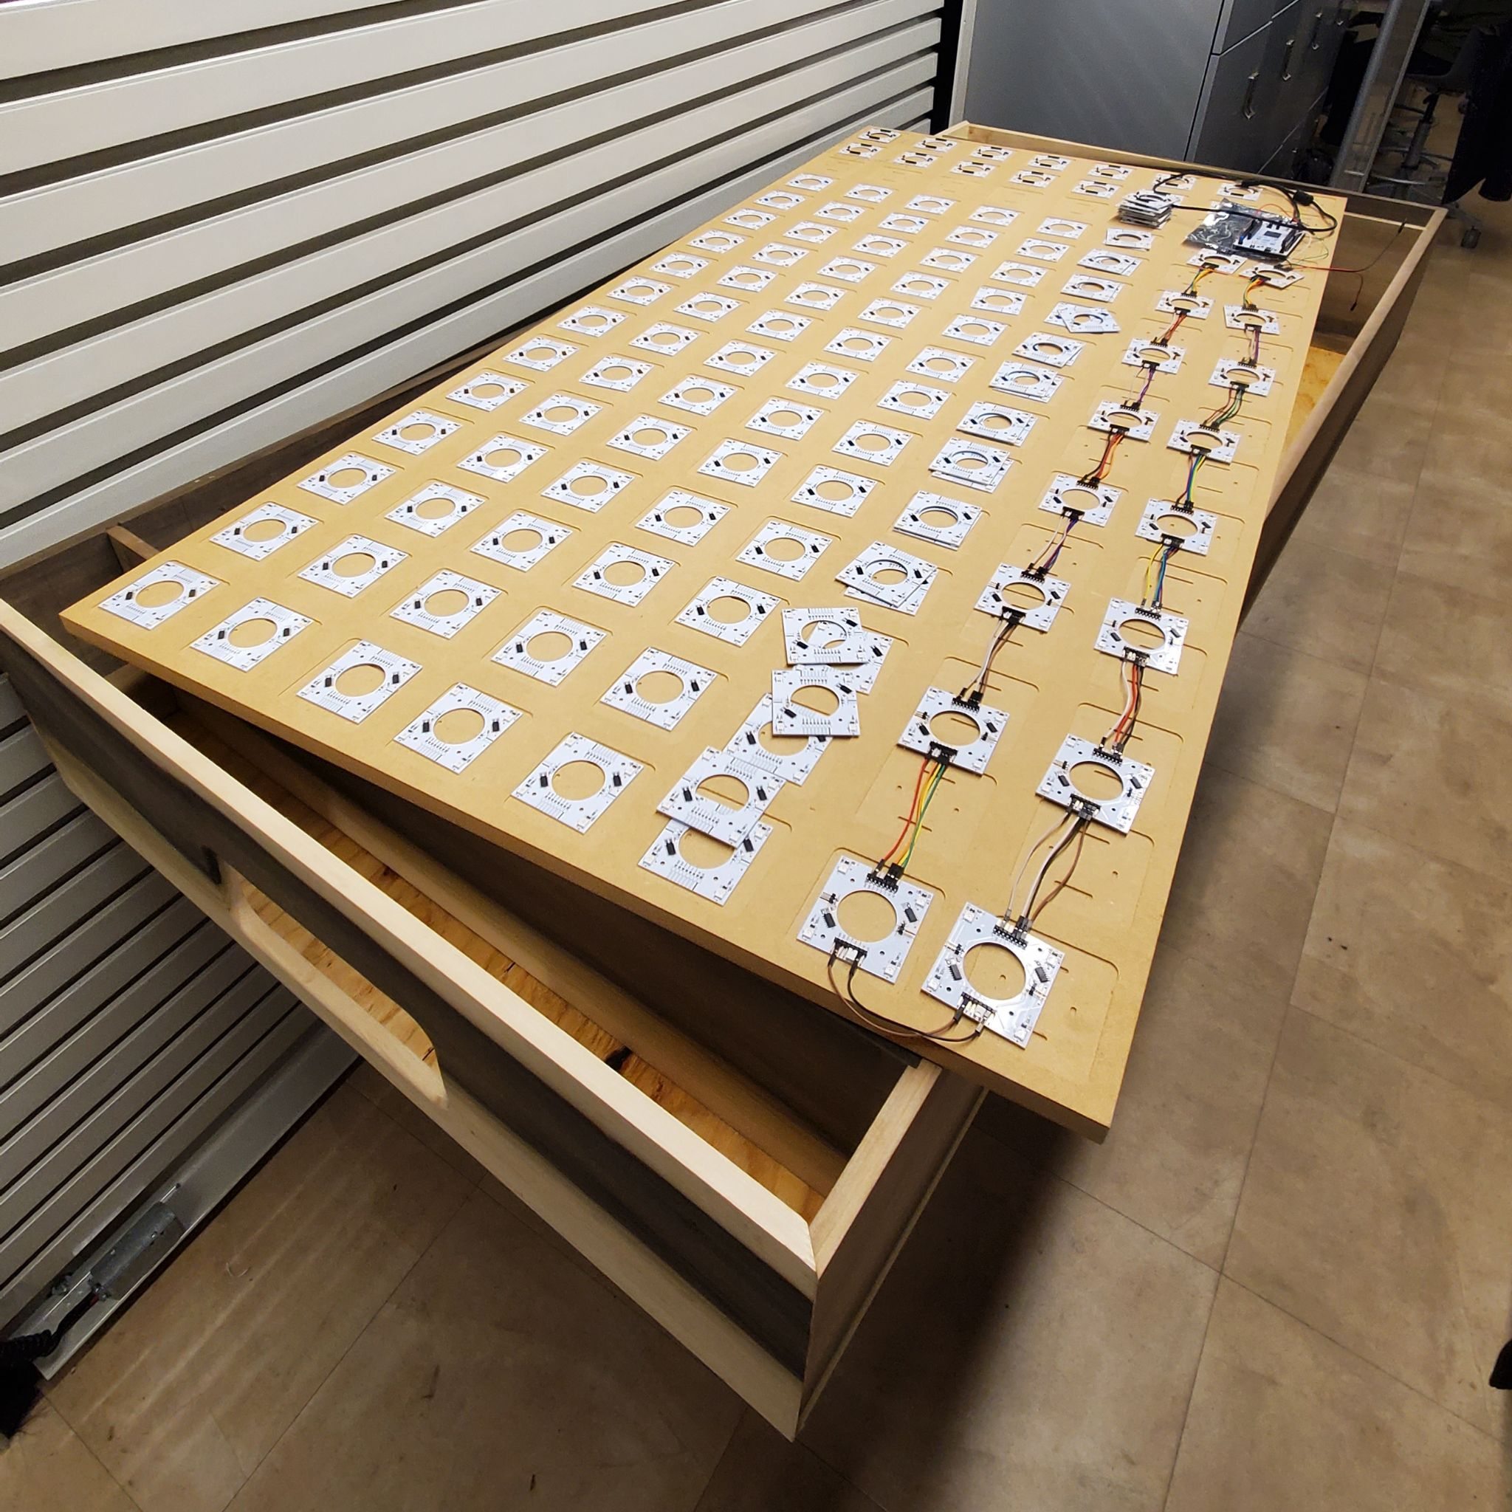
Overview of Individual Contributions (Will)
Overall Firmware Structure
Microcontroller Peripheral Configuration
LED Matrix Driver Firmware
Score Display Driver Firmware
Rotary Encoder Driver Firmware
Menu System Software
Contribute to Carpentry and Assembly

Slide 39
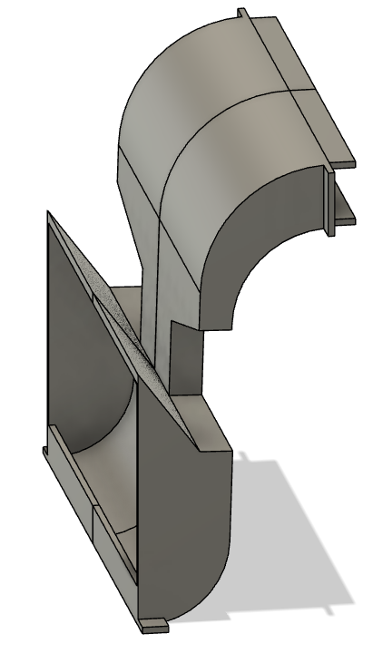
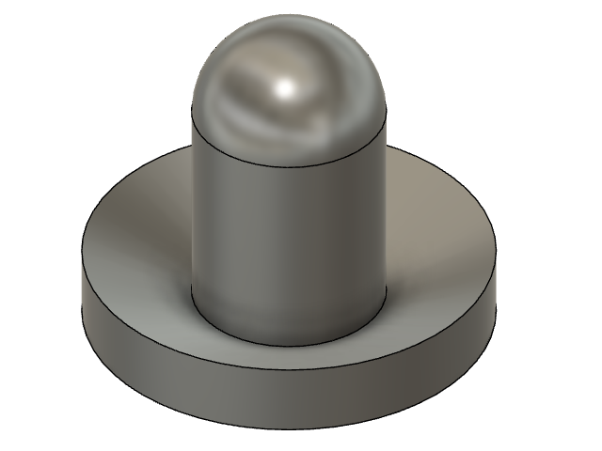
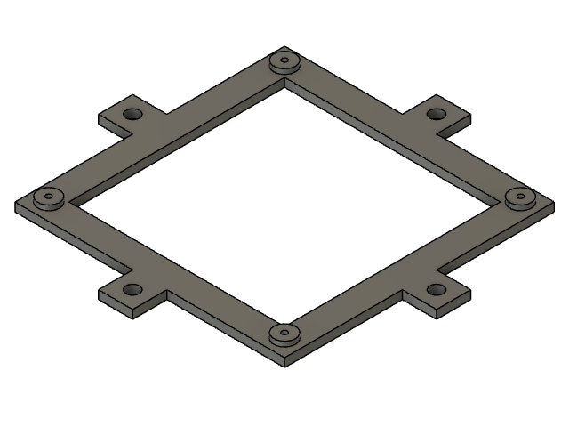
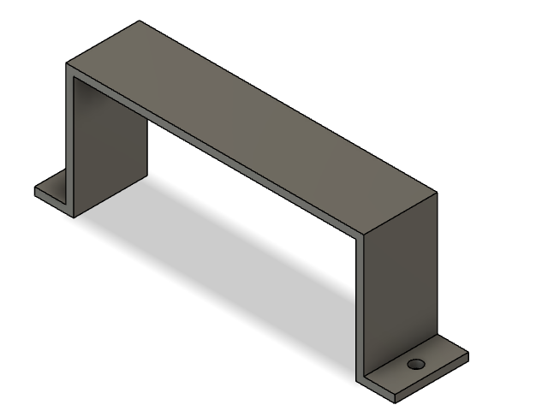
Overview of Individual Contributions (Will)
Overall Firmware Structure
Microcontroller Peripheral Configuration
LED Matrix Driver Firmware
Score Display Driver Firmware
Rotary Encoder Driver Firmware
Menu System Software
Contribute to Carpentry and Assembly
Goal Chute, Pusher, and Mounting Bracket CAD Models

Slide 40
Project Demonstration

Slide 41
PSDRs
PSDR #1 (Hardware): An ability for the microcontroller to determine the puck’s position on the playing surface by interpreting signals from a grid of hall effect switches beneath it, using digital gates to consolidate individual signals into row and column bit vectors.
PSDR #2 (Hardware): An ability for the microcontroller to automatically detect goals scored using an LED and analog photoresistor pair digitized using a comparator installed at each goal.
PSDR #3 (Hardware): An ability for the microcontroller to display game score on an OLED display using the SPI protocol.
PSDR #4 (Hardware): An ability for the microcontroller to control a large grid of individually-addressable WS2812B RGB LEDs beneath the playing surface using the LED’s custom communication protocol.
PSDR #5 (Hardware): An ability to provide power to the microcontroller at 3.3V using a buck converter from a 5V source.

Slide 42
EPSDRs
EPSDR #1 (Hardware): An ability for the microcontroller to store graphical animations and save game score on an EEPROM.
EPSDR #2 (Hardware & Software): An ability for the players to control the brightness of the RGB LED grid and winning game score number by interfacing with a rotary encoder and a menu on the OLED display.

Slide 43
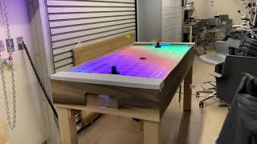
Video

Slide 44
Thank You!

